Slide 1
REST in the Wild
…and its cousins
March 30th, 2018
Notes:
honored that you are here on a friday before a holiday weekend

Slide 2



Josh Claxton
DriveTime Senior Developer
ASU Computer Science (2013)
Is this fool qualified?
6+ years professional development
Resident REST and API expert
Thesis project focused on REST
Organizing outreach with CIDSE advising
Why is he doing this?
Love mentoring/teaching
Ease the shock of the real world
Lead recruitment of Dev Interns
Notes:
Explain what DriveTime does.

Slide 3
I shared, now you share.
Discussion, not a lecture. Interrupt whenever.
What years are you?
What are your majors?
Any real life experience?

Slide 4
The plan
Quick review of REST/HATEOAS
REST in practice
Alternatives
Deployment Considerations
Questions and Discussion
Design Time REST (if we have time)

Slide 5
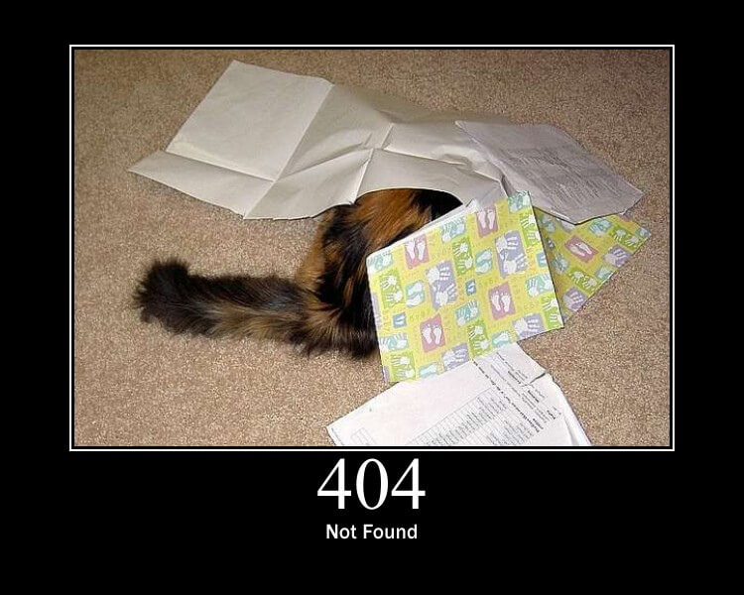
Quick review of REST/HATEOAS
REpresentational State Transfer / Hypermedia As The Engine Of Application State
A URI represents a resource on the internet
You can GET, PUT/PATCH, POST, DELETE to a resource to affect it
The resource should respond back with an HTTP code (200 OK, 404 Not Found)
With HATEOAS
Single entry point + Linked navigation
Reduce need for documentation
Encourage discoverability
https://http.cat/
An architectural style, but not a concrete implementation

Slide 6
Before I bombard you….questions?
Notes:
Summarize previous slide

Slide 7
What devs think REST is
Simple
“It’s like WCF, but with HTTP”
“It’s just URLs that take in JSON and return JSON” –
“Just methods that you call over HTTP. You return HTTP codes in response”
Normal
“URIs representing resources that you perform CRUD operations against”
Advanced
See previous slide
Guess who is most likely to be hired?

Slide 8

REST in practice
Most of the time, HATEOAS is completely ignored
Why do you think?
Too difficult and time intensive to design and implement
Difficult to consume correctly
Still needs a lot of documentation (kind of defeats the purpose, aye?)
“Ahead of its time”
Resources as URIs are very useful, but not the be-all, end-all
Mix in methods alongside the rest of the REST API for things that don’t fit
Easy to add (POST) a vehicle, update (PUT/PATCH) a vehicle, or remove (DELETE) a vehicle
Different to sell a vehicle
People still wrap the APIs with SDKs (remind you of anything?)
http://theautismhelper.com/wp-content/uploads/2016/04/ignoring-social-media.jpg

Slide 9
But that’s not what the books say!
Notes:
Summarize previous slide

Slide 10

Balance
The most important skill as a developer
Balance perfection and beautiful design against time to implement, complexity, readability, and efficiency
What else can we balance?

Slide 11
Case Study: Overly Complex
Notes:
Have to know the order of the methods
needs lots of documentation
requires an understanding of the model
Maybe we could have added HATEOAS to this….but still same problem.
Alternatively, we should have simplified it.
One POST to make EventTemplate
One PUT to update an EventTemplate
One POST to send an Event (not really RESTful. Performing an action)
Save time. Save money. Make it easier. REST was not the right choice for this, but you can do all that stuff! It just takes 5-6 API calls, documentation, and more.

Slide 12
Dude, that API sucked…
Notes:
Summarize previous slide

Slide 13

Other Examples
Pokémon API (a bit of HATEOAS)
https://pokeapi.co/api/v2/
SendSonar (Simple hybrid)
http://docs.sendsonar.com/docs/send-campaign
Gmail (More complex hybrid)
https://developers.google.com/gmail/api/v1/reference/
https://www.nintendo.dk/pokemon
Notes:
Explain purpose of each ap, where it is used, and some design decisions they made
Show mobile before going to the next slide

Slide 14
Cool. But why?
Notes:
Summarize previous slide

Slide 15
Case Study: Web of Web Services
https://mobile.drivetime.com/used-cars/az/mesa/mercedes-benz/c300/2015/1050158918
Notes:
Combine Services
This just makes up one page. Vehicle details. Not even complete.
also not all of these are rest apis.
real world just a bunch of service serving data. any other website is just like this.
Separation of concerns
- Separate logic, separate teams, just care about input/output

Slide 16
Sooo how does this apply to me?
Notes:
Summarize previous slide

Slide 17
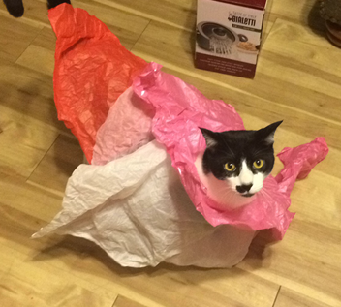
Alternatives
SOAP/WCF
RPC (GRPC)
GraphQL
#DogAlternative

Slide 18
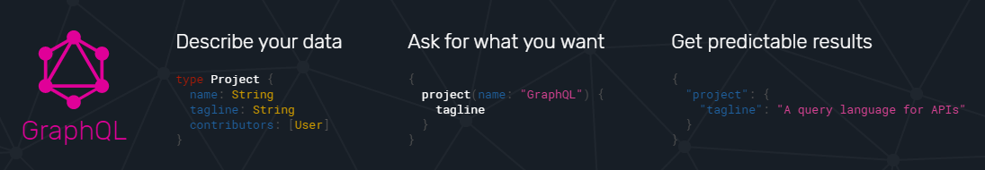
GraphQL
https://graphql.org/learn/

Slide 19
Huh?
Notes:
Summarize previous slide

Slide 20
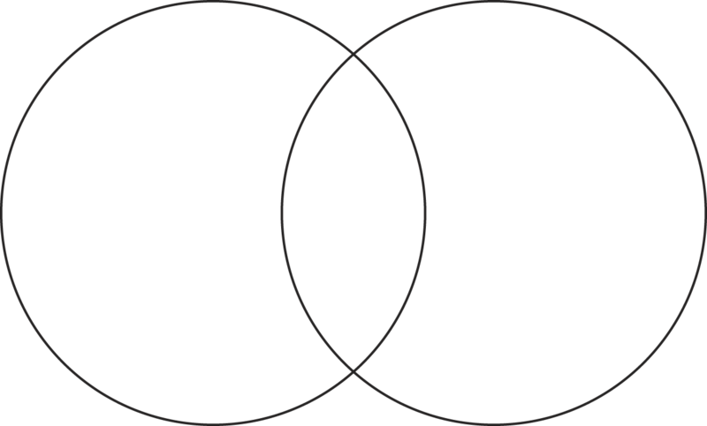
GraphQL
vs
REST
Client decides return structure
Server decides the return structure
Traverse a tree of data with one network call
Resource focused
One network call per resource
Pattern, not implementation
Single URI
Several URIs
Query Language
Retrieve/Modify data
URI and resource tied together
Which is better?
Notes:
important to know you may need to consume each of these.
its good to know them both.
yes it okay to use both.
REST. Don’t want to give the client control

Slide 21
That was a trick question. I don’t trust you.
Notes:
Summarize previous slide

Slide 22
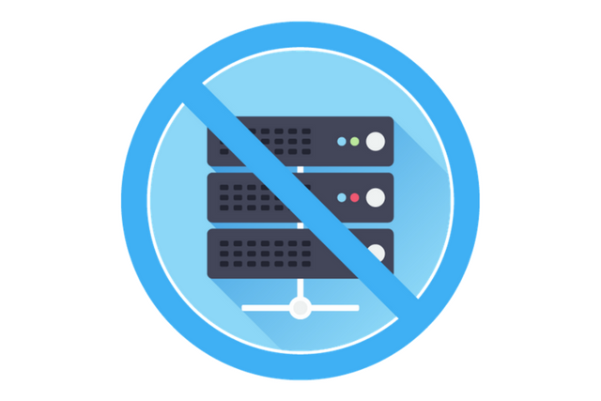
Deployment Considerations
WebApp
Dedicated server
Lots of methods and resources
Can be Monolithic
Microservices
Several dedicated servers
Highly focused APIs
Web of services
Serverless
“No server”
Deploy an individual function, not a collection
https://www.codeproject.com/Articles/1210776/Serverless-and-Playing-Around-With-MongoDB-Atlas
Notes:
Gmail app vs gmail user/messages/draft service
So you’ve made an API, how do you show it to the world?
Define fairly well, but difficult to decide when something is micro vs normal
WebApp (jack of all trades)
microservices(one things)

Slide 23




Ask me later!
Ask me now!
@JoshClax
joshclaxton
joshclax.com
(half tech, half cats)
https://www.pokemon.com/us/

Slide 24
Design time REST
http://www.joshclax.com/save-time-with-design-time-rest-apis/
https://app.swaggerhub.com/apis/joshclaxton/CardGame/1.0.0

